Slide 1



























Aneka Platform

Slide 2
Introduction
Manjasoft’s solution for developing, deploying and managing Cloud applications
Cloud Application Development Platform (CAP): pure PaaS solution
Aneka software framework provides
a middleware for managing and scaling distributed applications
an extensible set of APIs for developing them
The Aneka based computing cloud is a collection of physical and virtualized resources connected through a network, which are either the Internet or a private intranet.
2

Slide 3
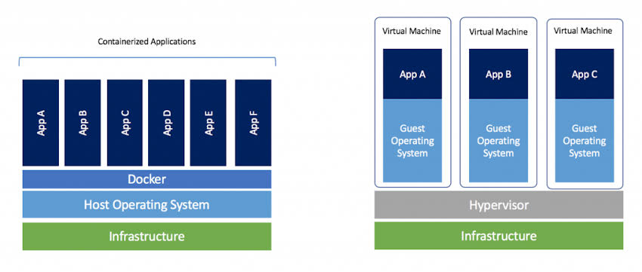
VM provides an abstract machine that uses device drivers targeting the abstract machine,
while a container provides an abstract OS.

Slide 4
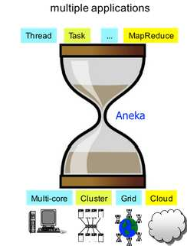
Introduction contd..
1. SDK
2. Runtime
multiple infrastructures
Fig. Aneka Capabilities at a Glance
4

Slide 5
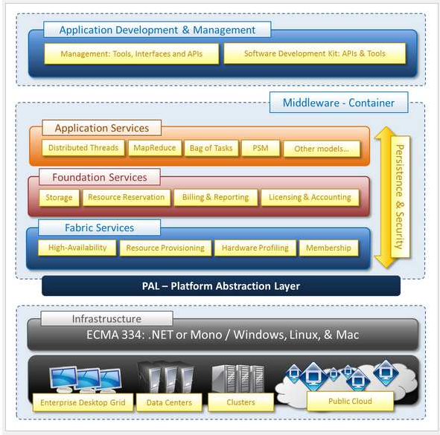
Aneka Framework
5

Slide 6
Platform Abstraction Layer(PAL)
Core infrastructure of the system is based on .NET technology
PAL provided features:
Uniform and platform-independent
implementation interface for accessing the hosting platform
access to remote nodes
management interfaces
Uniform access to extended and additional properties of the hosting platform

Slide 7
Fabric Services
Lowest level of the software stack representing Aneka container
Consists of
A) Profiling and Monitoring Services
B) Resource Management Services

Slide 8
Fabric Services contd..
A) Profiling and Monitoring Services
Heartbeat, Monitoring and Reporting services
Heartbeat service periodically collects the dynamic information about the node
The basic information about memory space, disk space, CPU and operating system are collected.
All these information can be stored on RDBMS or a flat file.

Slide 9
Fabric Services contd..
B) Resource Management Services
Comprises tasks: resource membership, resource reservation and resource provisioning service
Equivalent services: Index Service(Membership catalogue), Reservation Service, Resource Provisioning Service
The Membership catalogue tracks the performance information of nodes
The Resource Provisioning Service tracks the provisioning and lifetime information of virtual nodes.

Slide 10
Foundation Services
Logical management of the distributed system built on top of the infrastructure
A) Storage management for applications
B) Accounting, billing, and resource pricing
C) Resource reservation

Slide 11
Foundation Services contd..
A) Storage management
Centralized file storage
More suitable for compute-intensive applications
Distributed file storage
More suitable for data intensive applications
FTP is default option installed in Aneka
To support different protocols, the concept of file channel, is introduced.
File Channel identifies a pair of components:
file channel controller : server part
file channel handler : client part
Storage service supports the execution of task-based programming

Slide 12
Storage Management contd..
Storage service supports the execution of task-based programming such as Task and the Thread Model, and Parameter Sweep based applications.
Storage support for data intensive applications is provided by means of distributed file system.
Eg. Google File System
The only programming model that makes use of the distributed file system is MapReduce.

Slide 13
Storage Management contd..
B) Accounting, Billing, and Resource Pricing
Accounting keeps track of the status of applications in the Aneka cloud
Shows the usage of infrastructure and the execution of applications
Billing service provides detailed information about the resource usage of each user with the associated costs.
Each resource can be priced differently according to the different set of services that are available on the corresponding Aneka container or the installed software in the node.

Slide 14
Storage Management contd..
B) Resource Reservation
Supports the execution of distributed applications
Allows for reserving resources for exclusive use by specific applications
Checks with the Allocation Service that each job has the valid permissions to occupy the execution timeline by verifying the reservation identifiers.
QoS
3 Implementations:
Basic
Libra
Relay

Slide 15
Application Services
Manage the execution of applications
Constitute a layer that differentiates according to the specific programming model
Scheduling Service and Execution Service
Scheduling Service tasks:
Job-to-node mapping
Rescheduling of failed jobs
Job status monitoring
Application status monitoring

Slide 16
Application Services contd..
Execution Service tasks:
Controls the execution of single jobs that compose applications
Unpacking the jobs received from the scheduler
Retrieval of input files required for the job execution
Sandboxed execution of jobs
Submission of output files at the end of execution
Execution failure management
Performance monitoring
Packing jobs and sending them back to the scheduler

Slide 17
Application Services contd..
Currently supported programming model in the Aneka Cloud:
Task Model
Thread Model
MapReduce Model
Parameter Sweep Model

Slide 18
Application Development and Management
Aneka provides developers with a comprehensive and extensible set of APIs
Provides powerful and intuitive management tools to administrators
The Aneka SDK provides support for both programming models and services by means of the Application Model and Service Model.
The management tools consists of tools for
Infrastructure Management
Platform Management
Application Management
Aneka Cloud Management Studio handles all of these

Slide 19
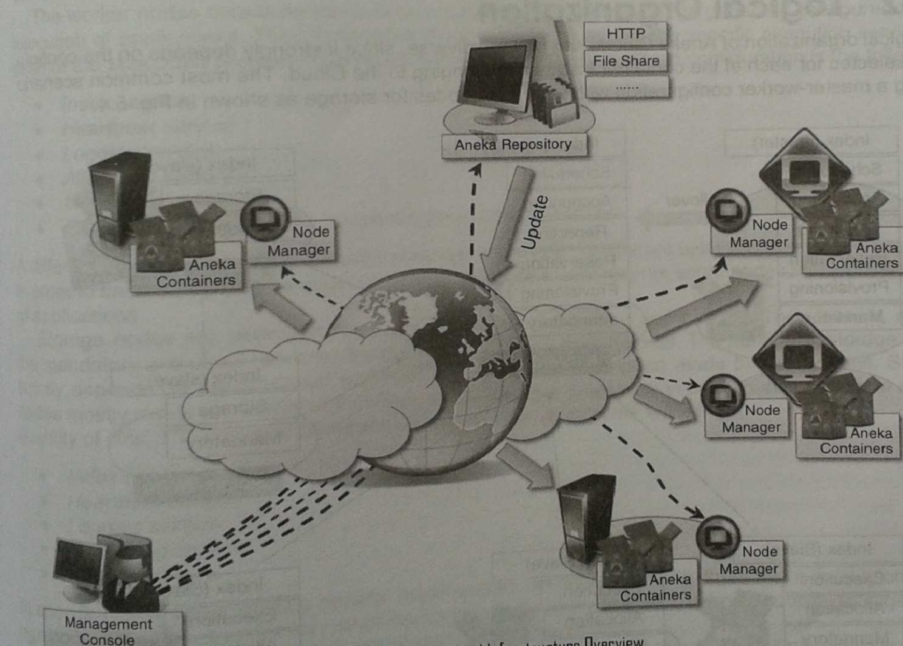
Building Aneka Cloud
Fig. Aneka Cloud Infrastructure Overview

Slide 20
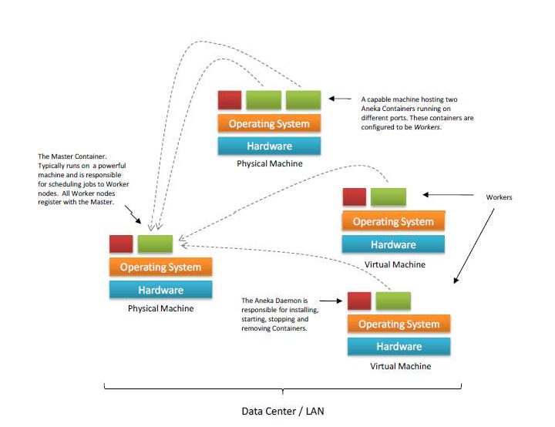
Building Aneka Cloud
Fig. A high-level view of an Aneka cloud

Slide 21
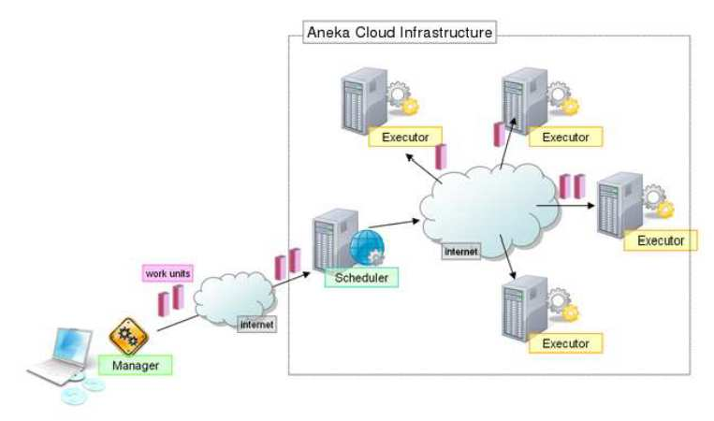
Building Aneka Cloud
Fig. System components view

Slide 22
Aneka Use Cases
Distributed Evolutionary Optimization: EMO
Distributed Learning Classifiers for Bioinformatics:XCS
Distributed Train Model Rendering: GoFront Group
Distributed Log Processing: TitanStrike Gaming

Slide 23
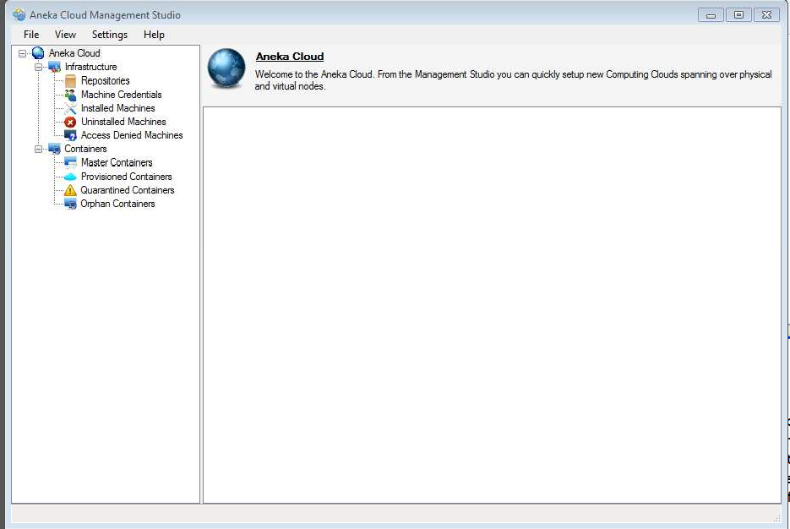
Aneka Software Screenshots

Slide 24
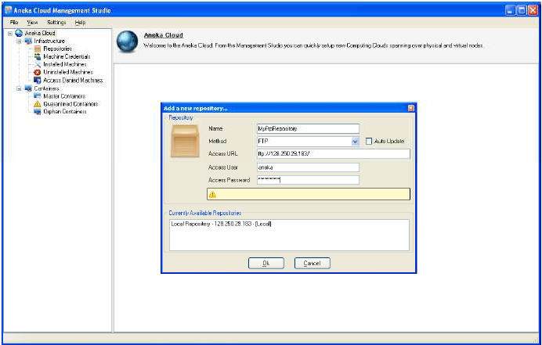
Aneka Software Screenshots

Slide 25
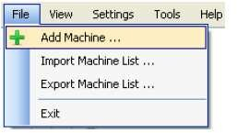
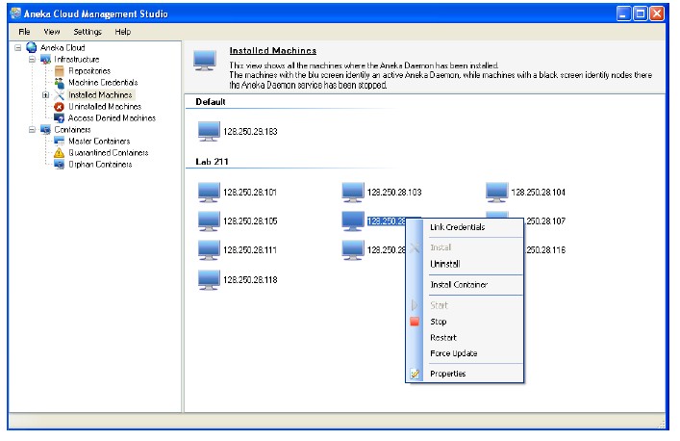
Aneka Software Screenshots

Slide 26
References
Buyya, Vecchiola, Selvi, Mastering Cloud Computing
http://www.manjrasoft.com/products.html
VECCHIOLA,, Xingchen CHU, and Rajkumar BUYYA, Cloud Computing and Distributed Systems (CLOUDS) Laboratory, Department of Computer Science and Software Engineering,The University of Melbourne, Australia,Manjrasoft Pty Ltd, Melbourne, Australia .
Aneka: A Software Platform for .NET-based Cloud Computing

Slide 27
Questions ??
Thank you

